Slide 1
ZOMATO DATA ANALYSIS
INSIGHTS

Slide 2
INSIGHT 1 : REPRESENTING THE FIRST FEW INTITIES OF THE DATASET
Unnamed: 0.1 | Unnamed: 0 | restaurant name | restaurant type | rate (out of 5) | num of ratings | avg cost (two people) | online_order | table booking | cuisines type | area | local address
0 | 0 | 0 | #FeelTheROLL | Quick Bites | 3.4 | 7 | 200.0 | No | No | Fast Food | Bellandur | Bellandur
1 | 1 | 1 | #L-81 Cafe | Quick Bites | 3.9 | 48 | 400.0 | Yes | No | Fast Food, Beverages | Byresandra,Tavarekere,Madiwala | HSR

Slide 3
INSIGHT 2 : TO FIND THE TOTAL NUMBER OF ROWS AND COLUMNS IN A TABLE
Data.shape()
(7105, 12)
THE DATASET CONTAIN 7105 ROWS AND 12 COLUMNS

Slide 4
INSIGHT 3 : STATICAL ANALYSIS OF DATA
 | Unnamed: 0.1 | Unnamed: 0 | rate (out of 5) | num of ratings | avg cost (two people)
count | 7105.000000 | 7105.000000 | 7037.000000 | 7105.000000 | 7048.000000
mean | 3552.000000 | 3552.000000 | 3.514253 | 188.921042 | 540.286464
std | 2051.181164 | 2051.181164 | 0.463249 | 592.171049 | 462.902305
min | 0.000000 | 0.000000 | 1.800000 | 1.000000 | 40.000000
25% | 1776.000000 | 1776.000000 | 3.200000 | 16.000000 | 300.000000
50% | 3552.000000 | 3552.000000 | 3.500000 | 40.000000 | 400.000000
75% | 5328.000000 | 5328.000000 | 3.800000 | 128.000000 | 600.000000
max | 7104.000000 | 7104.000000 | 4.900000 | 16345.000000 | 6000.000000

Slide 5
INSIGHT 4 : DROP THE NON INFORMATIONAL COLUMN FIRST TWO COLUMNS OF THE TABLE IS REMOVED
restaurant name | restaurant type | rate (out of 5) | num of ratings | avg cost (two people) | online_order | table booking | cuisines type | area | local address
0 | #FeelTheROLL | Quick Bites | 3.4 | 7 | 200.0 | No | No | Fast Food | Bellandur | Bellandur
1 | #L-81 Cafe | Quick Bites | 3.9 | 48 | 400.0 | Yes | No | Fast Food, Beverages | Byresandra,Tavarekere,Madiwala | HSR

Slide 6
INSIGHT 5 : TO FIND THE NAME OF ALL THE COLUMNS OF THE TABLE
Index(['restaurant name', 'restaurant type', 'rate (out of 5)', 'num of ratings', 'avg cost (two people)', 'online_order', 'table booking', 'cuisines type', 'area', 'local address'], dtype='object')

Slide 7
INSIGHT 6 : EXPLORATORY DATA ANALYSIS
THIS WILL REPRESENT THE NUMBER OF ORDERS FROM A GIVEN RESTRAUNT IN DESCENDING ORDER (TOP 10)
restaurant type
Quick Bites 2840
Casual Dining 1634
Cafe 403
Delivery 358
Takeaway, Delivery 289
Dessert Parlor 217
Bakery 154
Casual Dining, Bar 123
Beverage Shop 118
Bar 82
Name: count, dtype: int64

Slide 8
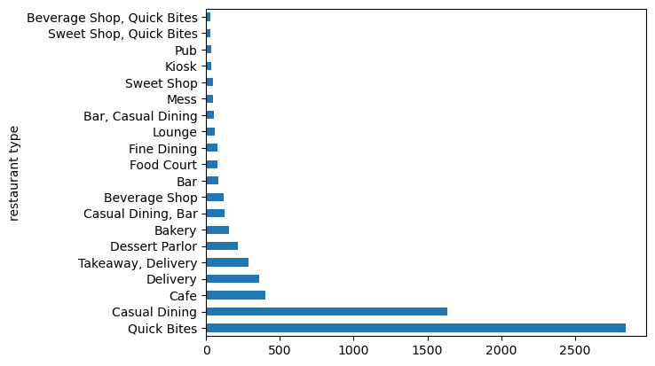
GRAPH OF TOP 20 RESTRAUNT IN WHICH Y AXIS REPRESENT NAME OF RESTRAUNT AND X REPRESENT THE VALUE COUNTS OF ORDERS

Slide 9
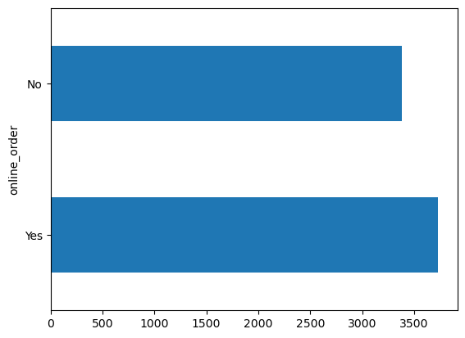
INSIGHT 7 : GRAPH TO REPRESENT THAT ONLINE ORDERS ARE MORE THEN DINE IN

Slide 10
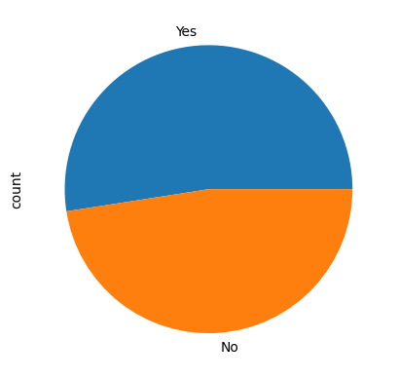
Online order Yes 3727 No 3378

Slide 11
INSIGHT 8 : GROUP BY LOCAL ADDRESS AND CALCULATE THE MEAN OF AVG COST (TWO PEOPLE) WHICH ADDRESS HAS MAXIMUM AVERAGE COST OF TWO PEOPLE
avg cost (two people)
local address
Sankey Road | 2886.363636
Lavelle Road | 1548.648649
Race Course Road | 1373.214286
MG Road | 1340.476190
Residency Road | 1205.769231
Infantry Road | 1086.363636
Langford Town | 1000.000000
Richmond Road | 957.500000
Seshadripuram | 905.128205
St. Marks Road | 897.619048

Slide 12
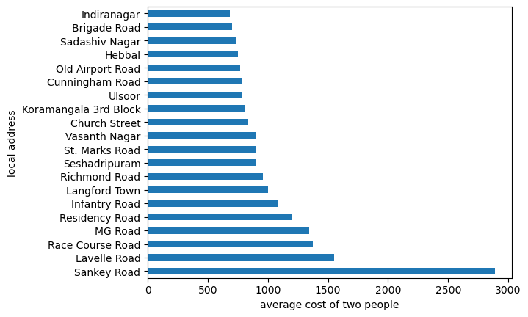
GRAPH OF LOCAL ADDRESS AND MEAN OF AVG COST (TWO PEOPLE)

Slide 13
RESULT :---- SANKEY ROAD HAS HIGHEST AVERAGE COST OF TWO PEOPLE
TOP 3
1 :- SANKY ROAD 2886.363636
2 :- LAVELLE ROAD 1548.648649
3 :- RACE COURSE ROAD 1373.214286

Slide 14
INSIGHT 9 :GROUP BY RESTAURNT TYPE AND CALCULATE THE MEAN OF RATINGS
rate (out of 5)
restaurant type
Bar, Pub | 4.600000
Microbrewery, Pub | 4.462500
Cafe, Lounge | 4.400000
Microbrewery, Bar | 4.400000
Fine Dining, Lounge | 4.400000
Casual Dining, Irani Cafee | 4.400000
Pub, Microbrewery | 4.400000
Fine Dining, Microbrewery | 4.300000
Casual Dining, Microbrewery | 4.260000
Fine Dining, Bar | 4.250000
Microbrewery | 4.216667

Slide 15
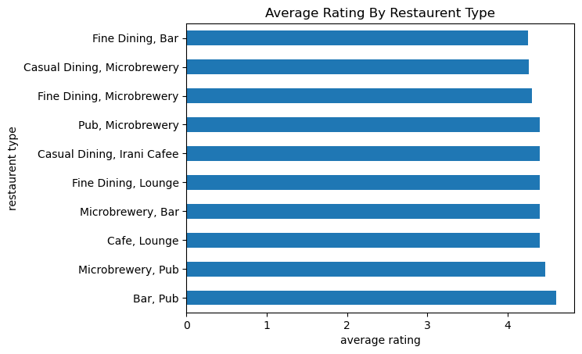
GRAPH OF RESTAURNT TYPE VS THE MEAN OF RATINGS

Slide 16
WRITE TOP 3 RESTRAUNTS OF HIGHEST RATINGS
RESULT 1:---- TOP 3 RESTRAUNT TYPE OF HIGHEST RATINGS ARE
A. BAR,PUB 4.600000
B. MICROBREWERY, PUB 4.462500
C. CAFE,LOUNGE 4.400000

Slide 17
2. WHICH RESTARUNTS HAS SAME NUMBER OF RATING
RESULT 2 :---- Cafe, Lounge Microbrewery, Bar Fine Dining, Lounge Casual Dining, Irani Cafee Pub, Microbrewery HAS SAME RATING OF 4.400000
AND Cafe, Bar, Lounge HAS SAME RATING OF 4.100000

Slide 18
INSIGHT 10 : TOTAL NUMBER OF RATING BY AREA GROUP BY AREA AND SUM OF THE NUMBER OF RATINGS
area
Byresandra,Tavarekere,Madiwala 204951
Brigade Road 153342
Indiranagar 151834
Bellandur 88538
Malleshwaram 77879
Brookefield 77138
Bannerghatta Road 70353
Banashankari 60459
Whitefield 50527
Koramangala 4th Block 45520
Name: num of ratings, dtype: int64

Slide 19
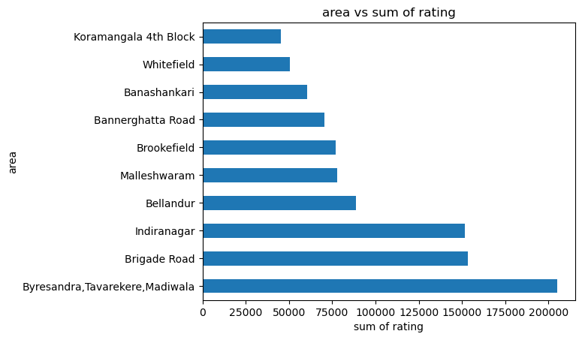
GRAPH OF AREA VS SUM OF RATING

Slide 20
WHICH AREA HAS THE MOST CUSTOMER ENGAGEMENT BASED ON RATINGS?
RESULT :----- Byresandra,Tavarekere,Madiwala HAS HIGHEST NUMBER OF RATING OF 204951

Slide 21
INSIGHT 10 : AVERAGE COST BY CUIZINE TYPE GROUP BY CUISINE TYPE AND COMPUTE THE AVERAGE OF AVERAGE COST (TWO PEOPLE)
cuisines type
French, Italian 6000.0
North Indian, Continental, Japanese, Chinese, South Indian 4100.0
Steak, Mediterranean, Grill 4000.0
North Indian, Kashmiri, Mughlai 3700.0
North Indian, Italian, Asian, Continental, Mediterranean 3500.0
Thai, Japanese, Chinese 3500.0
Mangalorean, Konkan, Seafood, Kerala 3500.0
North Indian, European, Thai 3400.0
North Indian, Italian, Chinese, Japanese 3400.0
American, North Indian, European, Tex-Mex 3000.0
Japanese, Chinese, Thai 3000.0

Slide 22
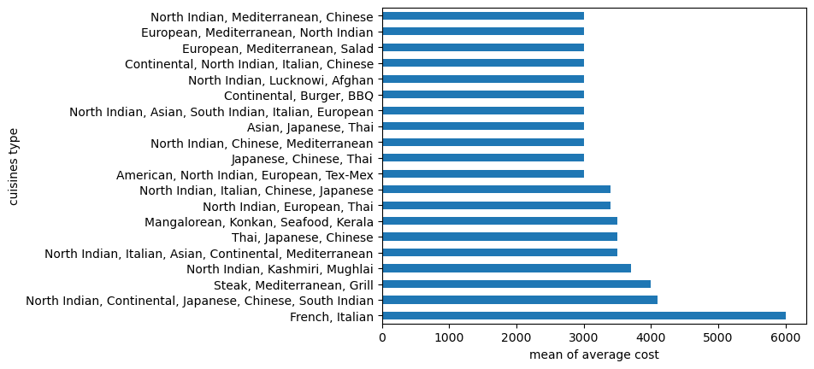
GRAPH OF AVERAGE COST VS CUIZINE TYPE

Slide 23
WHICH CUISINE ARE MORE EXPENSIVE ?
RESULT :---- THE MOST EXPENSIVE CUISINE IS FRENCH , ITALIAN OF AVERAGE COST OF TWO PEOPLE AS 6000.00

Slide 24
INSIGHT 10 :PROPORTION OF RESTAURANTS OFFERING ONINE ORDERS OR TABLE BOOKING
GROUPBY AREA OR RESTAURENT TYPE AND CALCULATE THE PROPORTION OF YES IN ONLINE ORDER OR TABLE BOOKING .
PREVALENT ARE ONLINE ORDERS AND TABLE BOOKINGS IN DIFFERENT AREAS ?
 | online_order | table booking
area
Banashankari | 0.629526 | 0.055710
Bannerghatta Road | 0.661232 | 0.077899
Basavanagudi | 0.457944 | 0.088785
Bellandur | 0.692521 | 0.102493
Brigade Road | 0.405172 | 0.191810
Brookefield | 0.672956 | 0.075472
Byresandra,Tavarekere,Madiwala | 0.614035 | 0.111529
Church Street | 0.246753 | 0.194805
Electronic City | 0.496278 | 0.076923
Frazer Town | 0.515873 | 0.039683
HSR | 0.464730 | 0.087137

Slide 25
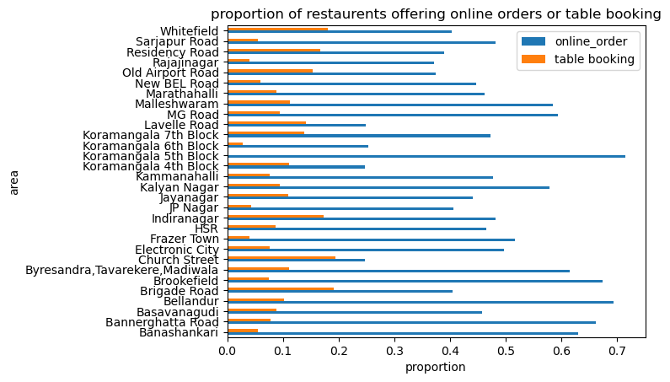
GRAPH OF AREA OR RESTAURENT TYPE VS THE PROPORTION OF YES IN ONLINE ORDER OR TABLE BOOKING

Slide 26
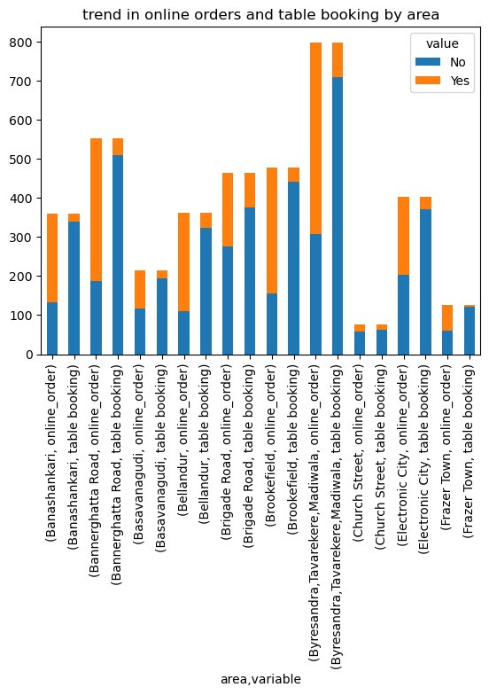
INSIGHT 10 : RATING COMPARISON ACROSS AREAS
CREATE A PIVOT TABLE WITH AREA AS ROWS AND RESTAURENT TYPE AS COLUMN AND AVERAGERATE (OUT OF 5) AS VALUES

